Slide 1



Final Project_Laxmi
View in Power BI
Last data refresh:
5/17/2023 7:35:04 PM UTC
Downloaded at:
5/17/2023 7:43:07 PM UTC

Slide 2
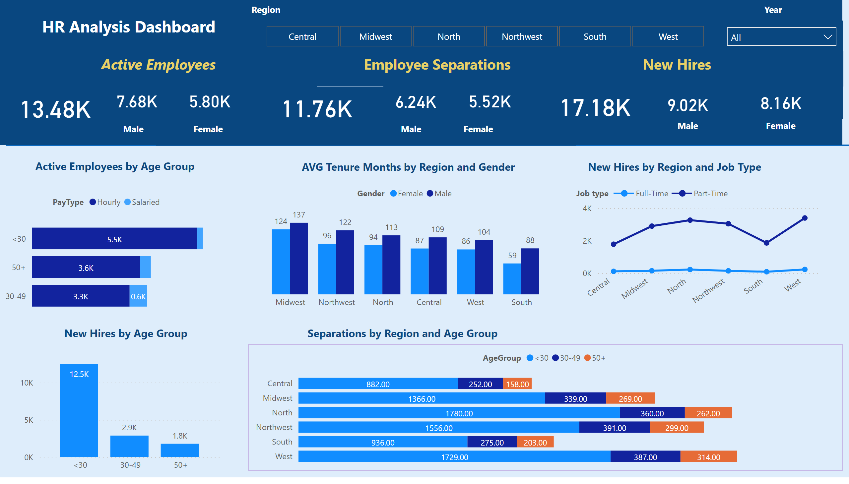
HR Analysis Dashboard
Notes:
textbox
No alt text provided
shape
No alt text provided
textbox
No alt text provided
card
No alt text provided
textbox
No alt text provided
textbox
No alt text provided
card
No alt text provided
textbox
No alt text provided
card
No alt text provided
card
No alt text provided
textbox
No alt text provided
card
No alt text provided
card
No alt text provided
card
No alt text provided
textbox
No alt text provided
card
No alt text provided
card
No alt text provided
textbox
No alt text provided
textbox
No alt text provided
textbox
No alt text provided
barChart
No alt text provided
columnChart
No alt text provided
textbox
No alt text provided
clusteredColumnChart
No alt text provided
textbox
No alt text provided
lineChart
No alt text provided
textbox
No alt text provided
barChart
No alt text provided
textbox
No alt text provided
slicer
No alt text provided
textbox
No alt text provided
slicer
No alt text provided
textbox
No alt text provided
textbox
No alt text provided

Slide 3
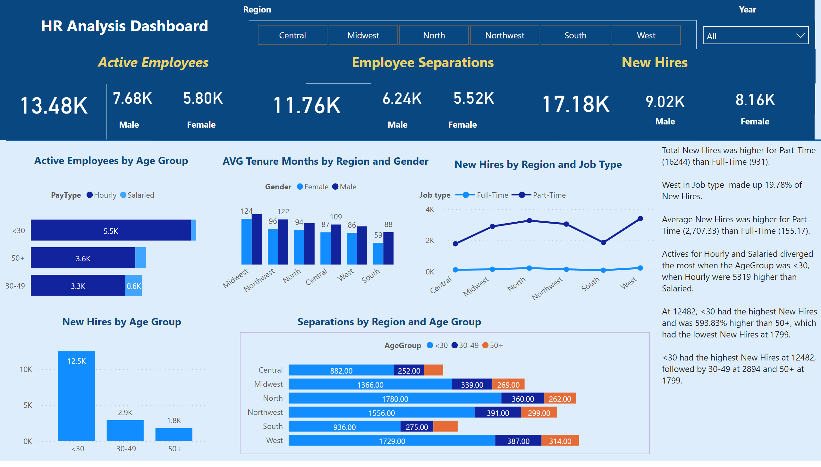
Duplicate of HR Analysis Dashboard
Notes:
textbox
No alt text provided
textbox
No alt text provided
shape
No alt text provided
textbox
No alt text provided
card
No alt text provided
textbox
No alt text provided
textbox
No alt text provided
card
No alt text provided
textbox
No alt text provided
card
No alt text provided
card
No alt text provided
textbox
No alt text provided
card
No alt text provided
card
No alt text provided
card
No alt text provided
textbox
No alt text provided
card
No alt text provided
card
No alt text provided
textbox
No alt text provided
textbox
No alt text provided
textbox
No alt text provided
barChart
No alt text provided
columnChart
No alt text provided
textbox
No alt text provided
clusteredColumnChart
No alt text provided
textbox
No alt text provided
lineChart
No alt text provided
textbox
No alt text provided
barChart
No alt text provided
textbox
No alt text provided
slicer
No alt text provided
textbox
No alt text provided
slicer
No alt text provided
textbox
No alt text provided
textbox
No alt text provided

